Slide 1


Virtual Safety
Keeping you and your students safe in our virtual world

Slide 2



Keeping Yourself Safer
Notes:
So you’re here to learn more about internet safety. You probably think I’m going to tell you the Internet is a dangerous place, to get off social networks and watch out for predators. But I’m not going to do that. I’m going to talk to you about making responsible online choices that will create a better environment for you and your friends. I’m going to talk about the risky decisions that some people make and some of things you might be facing, like cyberbullying, but also about what you can do to keep yourself safer.

Slide 3





Notes:
Do you use Google to do your homework? Update your profile from your cell phone? Game online all night? Download songs legally…or illegally? Post videos on YouTube? Do you wish you were texting right now?

Slide 4
SENDING
POSTING
No matter what you’re doing online, the key is to be responsible for your safety. That means not making decisions like sending mean texts, posting revealing pictures, talking to people you don’t know and talking about sex. Doing just one of these things might not get you in trouble, but a combination of these behaviors can really put you at risk.
TALKING
Notes:
Citation: Wolak J, Finkelhor D, Ybarra M. Online Predators and Their Victims: Myths, Realities and Implications for Prevention and Treatment. American Psychologist, 2008; 63:111-128.

Slide 5


Control Your Online Content
Notes:
To avoid this, you have to control what you put online. We’re going to talk about some ways to do that by going through some of the social applications and technologies you use, what you say when you’re on them, who you say it to, and what you show.

Slide 6


Be Careful What You Say!
Have you ever taken the time to read the comments on Facebook? What do you think about those people who use a lot of rude language or say offensive things? What do you think about those people who say those things? Maybe you think it is funny, but not everyone’s going to think so.
A Wisconsin teen posted a picture of a marijuana plant with the comment, “My Mary Jane that’s growing in my closet right now.” Can you guess what happened next? Police officers checking social networking sites for gang activity came across this comment and arrested him.

Slide 7
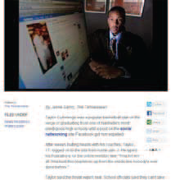
Facebook post gets Nashville Teen EXPELLED
Notes:
Because texts and status updates can sometimes be misunderstood or taken out of context, what you see as joking, someone else may take as a threat. This Tennessee teen was expelled from school after posting the status update, “I’ma kill em all.” and other threats to his Facebook page. He had been butting heads with his coaches and was frustrated. He now says that he didn’t mean anything by the threat, but his schhol wasn’t willing to take a chance.
Citation: http://www.wbir.com/news/local.story/aspx?storyid=112019

Slide 8
Watch What You Post
I HATE MY JOB! My boss is such a jerk!
Guess you forgot you added me to your friends. YOU’RE FIRED!
Notes:
It’s not just teens who have to watch what they post. An English woman complained about her boss and her job on Facebook. Unfortunately, she’d forgotten that her boss was one of her Facebook friends. Her boss read the comment and responded to it with one of his own – “You’re Fired!”
So before you post online, text something to a friend, or send any message or comment, you should ask yourself: will I regret this later? What will people think of me? And by “people”, I mean people other than your friends. Will your best friend have the same reaction as your teacher or parent?
Citation: http://cybersmokeblog.blogspot.com/2009/08/facebook-firing-after-friend-boss.html

Slide 9
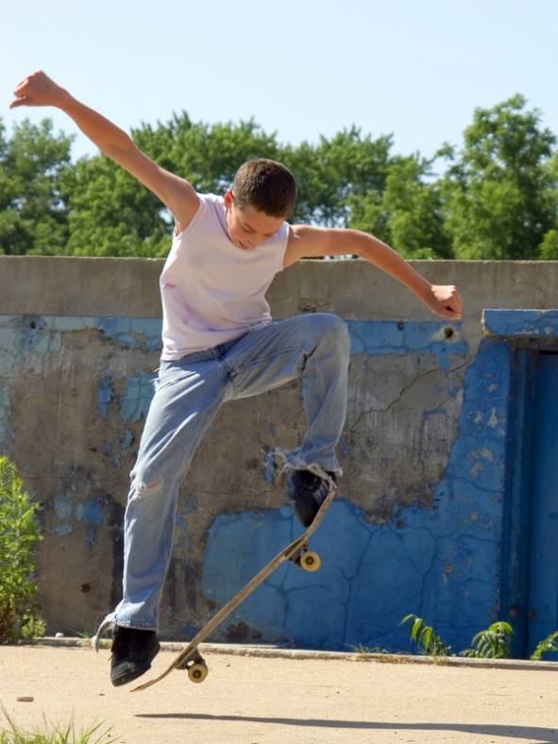



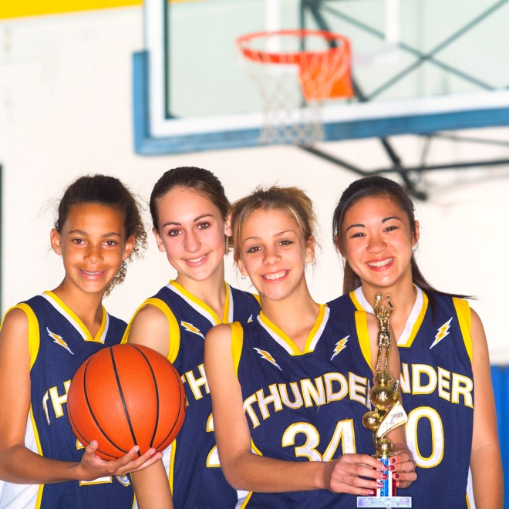


KNOW your friends
Notes:
People will react differently to the comments your post and the messages your test. That’s why it’s important that you are aware of who can see them and who you are sending them to. These are the people on your friends or contact lists.
What’s great about contact lists, like those on your Facebook page and cell phone, is that you get to choose who to add. And you should choose them carefully, because these people may be able to see any comment or picture you post. Someone on your friends list can save, copy and post your pictures and messages somewhere else online.

Slide 10

Choose to IGNORE
Notes:
If you play games online or through systems like Xbox or PlayStation, you may join games with people you don’t know. You may not be able to choose whether or not you play with them, but you CAN decide how to respond to them. If someone is being rude or offensive, you can choose to ignore them.

Slide 11
Privacy
Along with the people who bother you online, you can also use privacy settings to control WHO sees WHAT.
On Facebook you can choose between several levels of privacy. You may want some people blocked from seeing specific parts of your page, like pictures and videos.
When you are done today, check the privacy settings on the sites you’re using and make sure you’re not sharing information that you want to keep private.

Slide 12

Be Careful What You SHOW
Notes:
Setting your page to private is a good step, but it’s not a license to post anything you want. Along with being careful about what you say, you should also be careful about what you SHOW.
Pictures and videos that are sexy or show something inappropriate or illegal can get you into trouble. Remember the teen with marijuana? Along with his comment he had a picture of the marijuana plant growing in his closet. His story isn’t the only one.

Slide 13

Sexting
It’s just a photo…right?
Notes:
Teens have been caught drinking, smoking and doing other illegal things because of pictures and videos posted to their pages. Teens have also gotten into trouble for exchanging nude images with each other, either online or through picture messaging.
Ever heard of sexting? It’s when people take and send nude pictures or videos through their phones. Although some teens like to do it to joke around or to flirt with a crush or with their boyfriends or girlfriends, it can be illegal for minors. You’re probably thinking, “it’s my body. I can do what I want!” But if you have a picture like this on your phone, you can be charged with possessing child pornography. And if you send it to someone else, you can be charged with distributig it. Again, it doesn’t matter that it’s a picture you took of yourself; you can still be charged.

Slide 14

.
Your Photo Fate…
Notes:
It’s not only legal consequences you might have to deal with. You could lost scholarships, be kicked off athletic teams or lose your job. Even if it doesn’t get that far, teens who sext may find themselves humiliated at school if their pictures get out. If you don’t think it could be you, watch the video.
You should never pressure anyone into sexting because it can get really out of control.

Slide 15

Manipulated to meet offline…
Notes:
Did you see how easily that girl’s photo got passed around. So many people ended up seeing, including an online predator. Online predators are people who try to manipulate young people into sexual situations. Some want teens to send them nude pictures and some want teens to meet them offline for sex.
That might sound gross to your because you’re probably picturing some old guy like this

Slide 16


Be Safe

Slide 17



Grooming
Predators try to manipulate their victims into believing that they care for them.
Notes:
Predators try to manipulate their victims into believing they can care for them. This is called grooming. They might send gifts like bus or plane tickets to try to get you to meet offline. A free cell phone might sound really good, but its just a way for predators to communicate with you without anyone knowing. Predators want to keep you isolated from your family and friends, because then you’ll have to turn them for support. Everything that a predator does, NO MATTER HOW NICE IT SEEMS, is really about getting you to think about se, whether it’s sending revealing pictures or meeting offline.

Slide 18
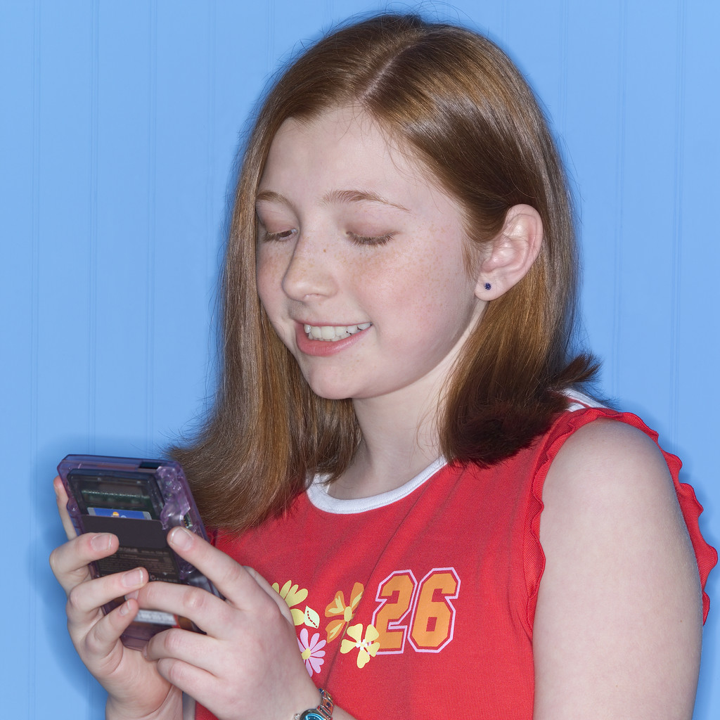
ANYONE can be a victim
Notes:
So you might be thinking, “I wouldn’t fall for that.” Everybody thinks the typical grooming victim is not them. It’s not their friends. It’s not their family. But, anyone can be a victum. Teens that are feeling lonely or misunderstood might look for friendship, attention or affection from someone they might meet online. And if you’re thinking it’s only girls, think again. It happens to boys too.

Slide 19

Survivor Diaries
Notes:
What you should know in order to prevent yourself from becoming a victim is that predators focus their attention on kids who respond to them. The teens in this video, Ryan and Noah, were both going through a rough time when they were targeted by predators. Let’s see what happened.

Slide 20
Cyber TipLine
Anyone who sends you OBSCENE PHOTOS or VIDEOS
Anyone who talks t to you about SEX
Anyone who asks you to MEET OFFLINE
REPORT
www.cybertipline.com
1-800-THE-LOST
Notes:
Ryan and Noah’s predators made them feel like they didn’t have any control over the situation. But when they decided to report, they took control. It’s important that you do the same. No matter how hopeless a situation feels, you always have the power to do something.
If someone makes you uncomfortable online, report it to the National Center for Missing & Exploited Children’s CyberTipLine. Report anyone who sends you obscene photos or videos, Anyone who talks to you about sex, and Anyone who asks you to meet offline.
It’s important to report, even if you’re not bothered by it. You can help protect somebody else, maybe even someone close to you. Reporting means you’re standing up for yourself and making sure no one else becomes a victim.

Slide 21

Cyberbullying
Look what happened after school!!
Notes:
Now that we’ve talked about how to deal with online predators, let’s talk about how to deal with another online threat-cyberbullying. This is a word that you may or may not use, but you probably know what I’m talking about. Cyberbullying is exactly what it sounds like – the combination of bullying and technology. It can be someone sending mean text messages all night long or creatind a fake profile or hate group on Facebook.

Slide 22

How it Hurts
Notes:
Whether you intend something as a joke or you’re trying to intentionally hurt someone’s feelings, a cyberbullying act can have devastating effects on the target.
In one cyberbullying case, a teen found herself the victim of two girls who created fake Facebook accounts for her. They passed her pictures on nude bodies and made rude comments about her. They did it because “they thought it would be funny,” but would it be funny if it happened to you.
Citation: http://www.newspress.com/article/20110114/crime/101140405/1075/Facebook-postings-lead-to-charges-against-2-Esterto-High-students

Slide 23
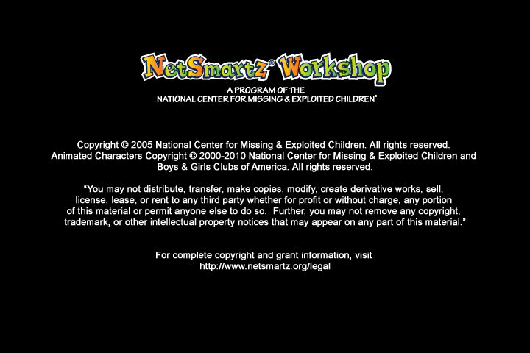
You CAN’T Take It Back
Notes:
That girl had to face the fact that teens all over her school district could see the fake accounts. She was humiliated, but this could have been avoided IF someone had stood up and reported the bullying. As you watch this video, imagine how differently this situation would have played out of the boy had reported it instead of joining in.

Slide 24
Join in
Laugh
Ignore
Report
If you have seen gossip sites going around your school, you have a few options.
You could, like the boy, choose to join in and add to the comments.
You could read the gossip and laugh.
You could choose to ignore it, this seems like a good idea. It keeps you out of trouble and you really aren’t doing anything mean.
You do have a fourth option: you can report it.
If you sit by and do nothing, you’re letting a bad situation get worse.
Notes:
Think about the boy in the video, he could have said something when he first saw the website, but he didn’t. Then he found out that his sister was affected and regretted not doing something about it earlier.

Slide 25
DON’T respond
BLOCK/BAN the bully
SAVE the evidence
SET UP new accounts
TELL an adult you trust
REPORT
Notes:
So if you or someone you know is being cyberbullied, what should you do??
First, don’t respond to the messages
Then, block or ban the bully
Save the evidence
Tell an adult your trust
And, Report it to the website
And while there’s probably no website where you can be completely safe from cyberbullying, you can refuse to be a bully and ecourage your friends to do the same. Also, be sure to check out the safety pages on sites like Facebook and YouTube which have advice about how to handle bullies and navigate their sites more safely.

Slide 26

Are you doing the BULLYING?
Notes:
Maybe these cyberbullying stories sound familiar because YOU are the one doing the bullying? If so, you should know that kids have gotten into trouble for cyberbullying. In Texas, some high school football players were suspended from their team for making a fake profile for their coach. One teen in Missouri spent two weeks in jail after he created an online hate group for a girl in his school.
You might think the kinds of teens who get in trouble for cyberbullying are already troublemakers, but that’s not already true. Anyone can get into a situation when they’re tempted to send a mean text, make a mean comment or forward an embarassing picture.
Citation: http://www.heartlandconnection.com/news/story.aspx?id=373808

Slide 27


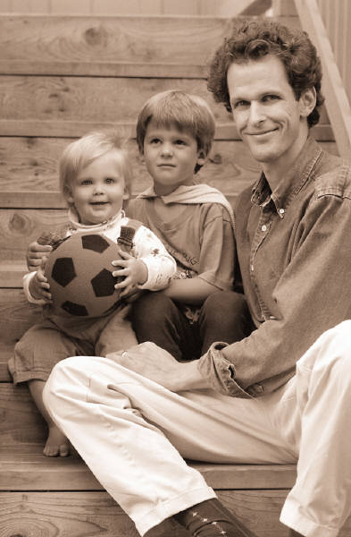



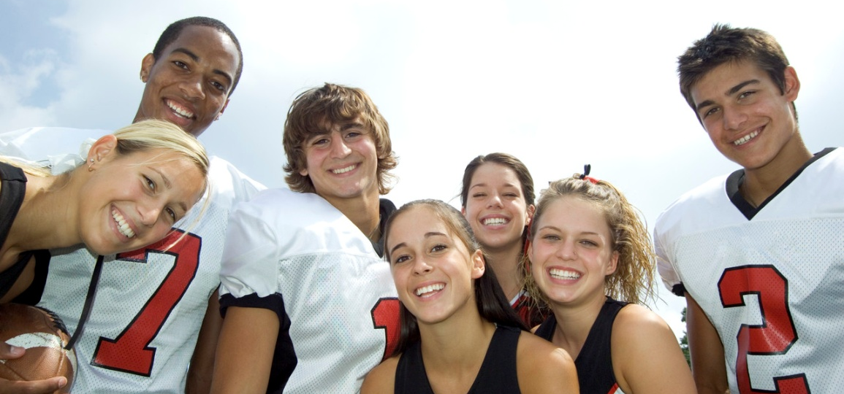

Future
Employers
Parents
Predators
Teachers
Cyberbullies
Notes:
You have to think before you post because what you post online can be seen by more than your friends on social networking sites or the contacts in your phone. It may be seen by all these people.
On the internet, nothing is secret. People can forward messages, copy your pictures and post them somewhere else. So if you’re not okay with ALL these people seeing your online post, then don’t post it. And if you’re not okay with being contacted by all of these people, then don’t give your cell phone number out to everyone or have a public profile. Whatever you say can be traced back to you, so make it something you’re proud of saying. Remember, at the end of the day you are responsible for what you post and who you talk to.
Citation: http://www.netsmartz.org

